Slide 1

Pointers

Slide 2
Addresses in Memory
When a variable is declared, enough memory to hold a value of that type is allocated for it at an unused memory location. This is the address of the variable
2000 2004 2008
int x;
float number;
char ch;
x number ch

Slide 3
Obtaining Memory Addresses
The address of a non-array variable can be obtained by using the address-of operator &
int x;
float number;
char ch;
cout << “Address of x is “ << &x << endl;
cout << “Address of number is “ << &number << endl;
cout << “Address of ch is “ << &ch << endl;
2000 2004 2008
x number ch

Slide 4
What is a pointer variable?
A pointer variable is a variable whose value is the address of a location in memory.
To declare a pointer variable, you must specify the type of value that the pointer will point to, for example,
int *ptr; // ptr will hold the address of an int
char *q; // q will hold the address of a char

Slide 5
Using a Pointer Variable
2000
12
x
3000
2000
ptr
NOTE: Because ptr holds the address of x, we say that ptr “points to” x
int x;
x = 12;
int *ptr;
ptr = &x;

Slide 6
* is the dereference operator
int x;
x = 12;
int *ptr;
ptr = &x;
cout << *ptr;
2000
12
x
3000
2000
ptr
NOTE: The value pointed to by ptr is denoted by *ptr

Slide 7
Using the Dereference Operator
int x;
x = 12;
int *ptr;
ptr = &x;
*ptr = 5;
2000
12
x
3000
2000
ptr
5
// changes the value at the
address ptr points to 5

Slide 8
Self –Test on Pointers
char ch;
ch = ‘A’;
char *q;
q = &ch;
*q = ‘Z’;
char *p;
p = q;
4000
A
ch
5000
4000
q
Z
6000
4000
p
// the rhs has value 4000
// now p and q both point to ch

Slide 9
Pointers and arrays
When an array is declared, the compiler allocates a base address and sufficient amount of storage to contain all the elements of the array in contiguous memory locations
The base address is the location of the first element (index 0) of the array.
The compiler also defines the array name as a constant pointer to the first element.
compiler converts: x[i] = *(x + i)

Slide 10
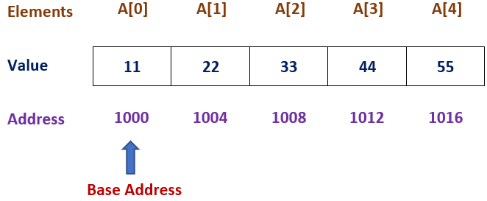
Suppose we declare an array A as follows:
int A[5] ={ 11,22,33,44,55 };
Suppose the base address of A is 1000, and assuming that each integer requires 4 bytes, the five elements will be stored as follows.

Slide 11
The name A is defined as a constant pointer pointing to the first element, A[0] and therefore the value of A is 1000, the location where A[0] is stored.
That is A =&A[0] =1000
If we declare p as an integer pointer, then we can make the pointer p to the array A by the following statement.
p=A; This is equivalent to p=&A[0];
Now we can access every value of A using p++ to move from one element to another.

Slide 12
p= &A[0] (=1000)
p+1=&A[1] (=1004)
p+2=&A[2] (=1008)
p+3=&A[3] (=1012)
p+4=&A[4] (=1016)
Address of A[3] = base address + (3 x scale factor of integer) =1000 +(3*4) =1012

Slide 13
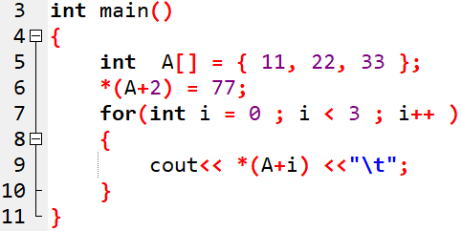
Accessing array elements using constant pointer

Slide 14
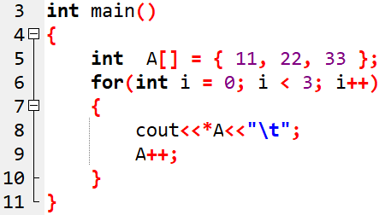
Error

Slide 15
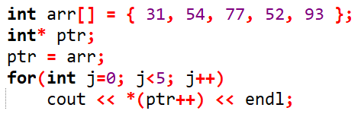
Array accessed with pointer

Slide 16
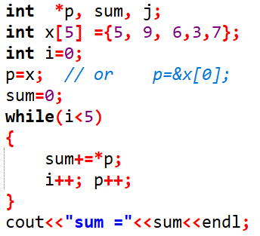
Write a C++ program to compute the sum of all elements stored in an array using pointers.

Slide 17
If you remember
char str [ 8 ];
str is the base address of the array.
We say str is a pointer because its value is an address.
It is a pointer constant because the value of str itself cannot be changed by assignment. It “points” to the memory location of a char.
6000
‘H’ ‘e’ ‘l’ ‘l’ ‘o’ ‘\0’
str [0] [1] [2] [3] [4] [5] [6] [7]

Slide 18
Using a Pointer to Access the Elements of a String
char msg[ ] =“Hello”;
char *ptr;
ptr = msg;
*ptr = ‘M’ ;
ptr++;
*ptr = ‘a’;
msg
3000
‘H’ ‘e’ ‘l’ ‘l’ ‘o’ ‘\0’
‘M’
‘a’
3000
3001
ptr

Slide 19
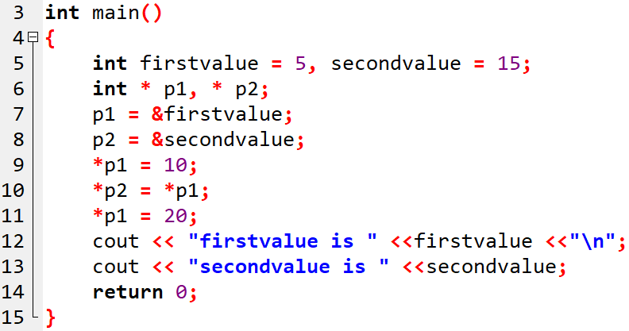

Question-1: What is the output ?
OUTPUT

Slide 20
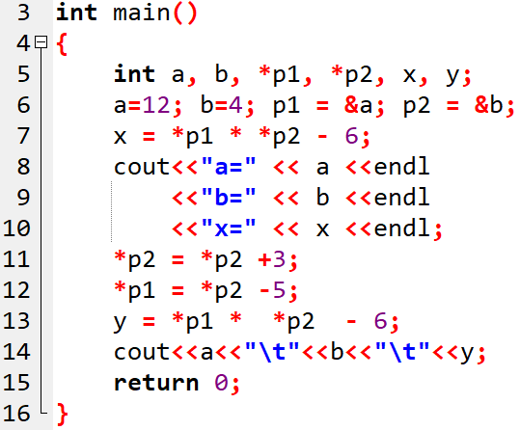

Question-2: What is the output ?
OUTPUT

Slide 21
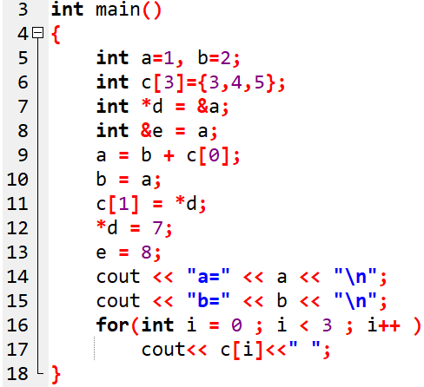

Question-1: What is the output ?
OUTPUT:

Slide 22
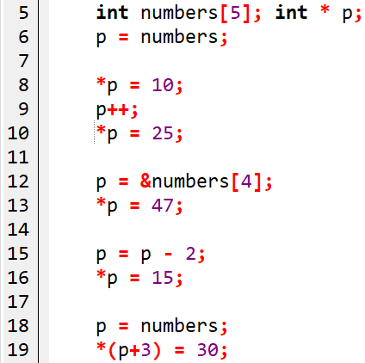
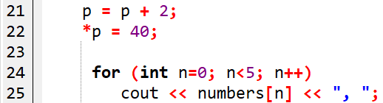
Question-2: What is the content of the array?

Slide 23
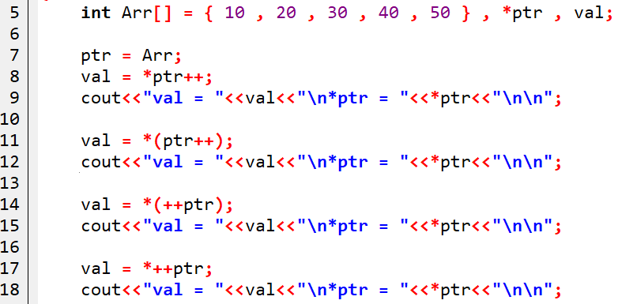
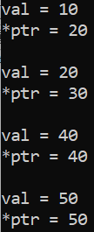
Question-3:
OUTPUT:
Notes:
Deref and postfix has equal precedence, so associ.rule L->R
4th…prefix ---associ.rule R->L
Note→ ++*ptr; means value is incremented.

Slide 24
Pointers and character strings
The statement char *cp =name;
declares cp as a pointer to a character and assigns address of the first character of name as the initial value.
The statement while(*cp!=‘\0’) is true until the end of the string is reached.
When the while loop is terminated, the pointer cp holds the address of the null character.
The statement length = cp – name; gives the length of the string name.

Slide 25
The following statements are valid.
char *name;
name =“Delhi”;
These statements will declare name as a pointer to character and assign to name the constant character string “Delhi”

Slide 26
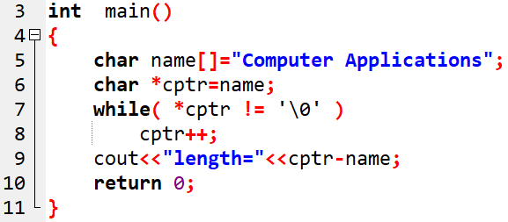
//Program to find the length of the string

Slide 27
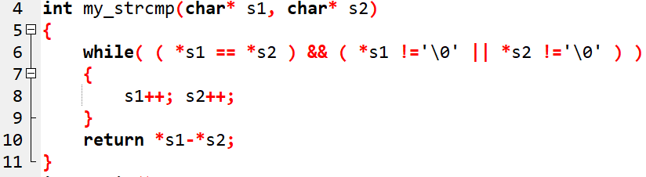
Strcmp() function:
int my_strcmp ( char *s1 , char *s2 )

Slide 28
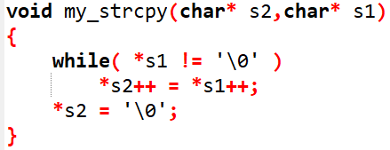
Strcpy() function: void my_strcpy ( char *dest, char *src )

Slide 29
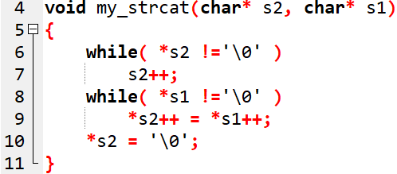
void my_strcat ( char *dest, char *src )
Strcat() function:

Slide 30
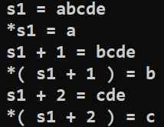
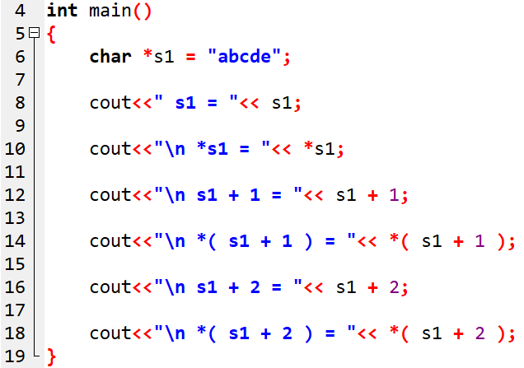
Question
OUTPUT:

Slide 31
Handling Table of Strings
char name[3][25];
This says that the name is a table containing 3 names, each with a maximum length of 25 characters (including null character)
The total storage requirements for the name table are 75 bytes
We know that rarely the individual strings will be of equal lengths.
Therefore, instead of making each row a fixed number of characters, we can make it a pointer to a string of varying length.

Slide 32
Array of strings
char *name[3] = { “New Zealand”, “Australia”, India”};
Declares name to be an array of 3 pointers to characters, each pointer pointing to a particular name as shown below.
name[0] → New Zealand
name[1]→ Australia
name[2]→ India
The following statement would print out all the 3 names.
for( i = 0 ; i < 3 ; i++ )
cout << name[ i ];

Slide 33
Dynamic memory allocation
new and delete
  operators used to allocate and free memory at run time
The new operator allocates memory and returns a pointer to the start of it
delete operator frees memory previously allocated using new

Slide 34
Dynamic Memory Management : new and delete:
  Syntax:
  Pointer_variable = new data_type;
  Pointer_variable = new data_type(value);
  Pointer_variable = new data_type[size];
Eg: int *p1 = new int;
int *p2 = new int(5);
int *p_arr = new int[10];

Slide 35
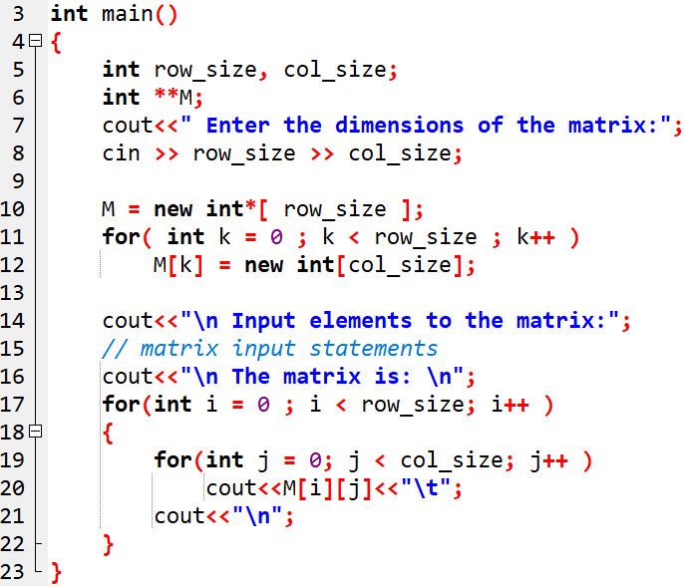
Memory allocation to 2D array

Slide 36
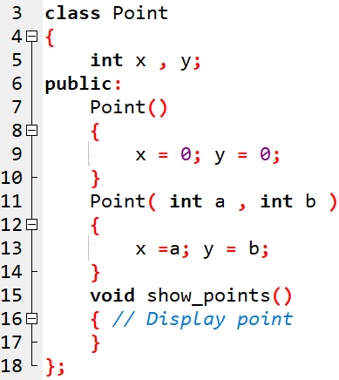
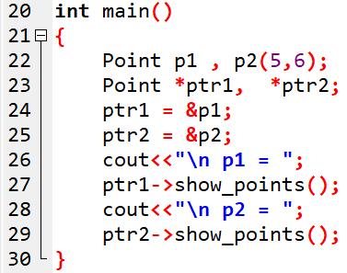

Pointer to object: Example-1

Slide 37
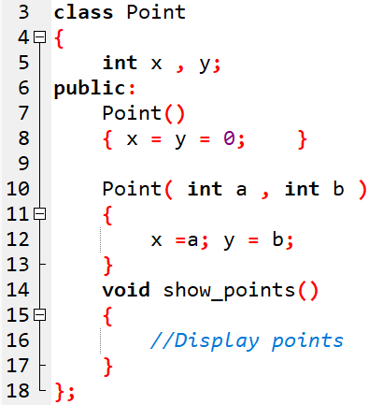
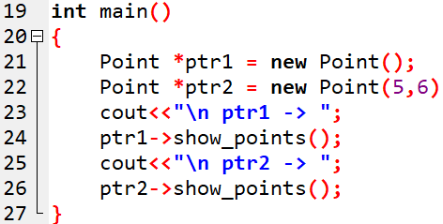

Pointer to object: Example-2

Slide 38
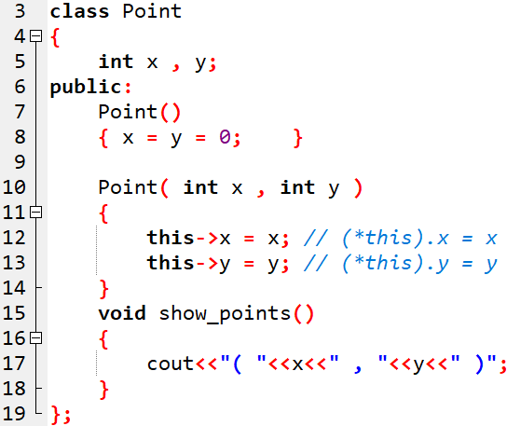
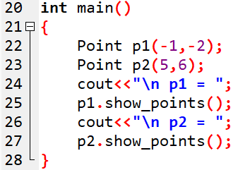
“this” pointer

Slide 39
“this” pointer
class Test
{
private:
int a;
public:
void assign (int a)
{
// The 'this' pointer is used to retrieve the object's x
// hidden by the local variable 'x'
this->a = a;
}
void print() { cout << “a = " << a << endl; }
};
int main()
{
Test t1;
int a = 20;
t1.assign(a);
t1.print();
return 0;
}
Notes:
/* local variable is same as a member's name */

Slide 40
Destructors
delete calls the object’s destructor.
delete frees space occupied by the object.
A destructor cleans up after the object.
Releases resources such as memory.
Syntax: delete pointer_variable;
delete []array_pointer;

Slide 41
Malloc | New
Standard C Function | Operator
Used sparingly in C++; used frequently in C | Only in C++
Does not invoke any constructor | Invokes constructor of the class for object initialization.
Returns void* and requires explicit casting | Returns the proper type
Returns NULL when there is not enough memory | Throws an exception when there is not enough memory
Every malloc() should be matched with a free() | Every new/new[] should be matched with a delete/delete[]

Slide 42
Pointers and structures
Consider the following structure
struct inventory
{
char name[30];
int number;
float price;
} product[2], *p;
p=product; assigns the address of the zeroth element of product to p
or p points to product[0];

Slide 43
Pointers and structures (Contd…)
Its members are accessed using the following notation
p->name
p->number
p->price
The symbol -> is called arrow operator (also known as member selection operator)
The member number can also be accessed using
(*p).number
Parantheses is required because ‘.’ has higher precedence than the operator *

Slide 44
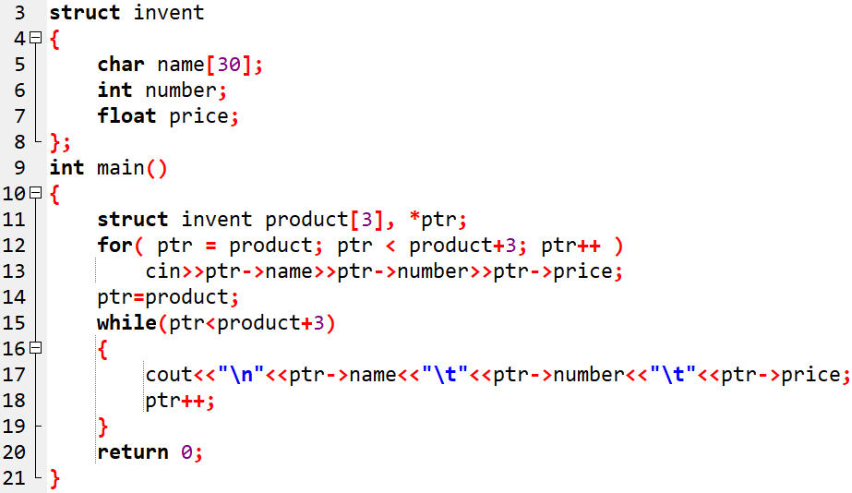
Program to illustrate the use of structure pointers

